Slide 1
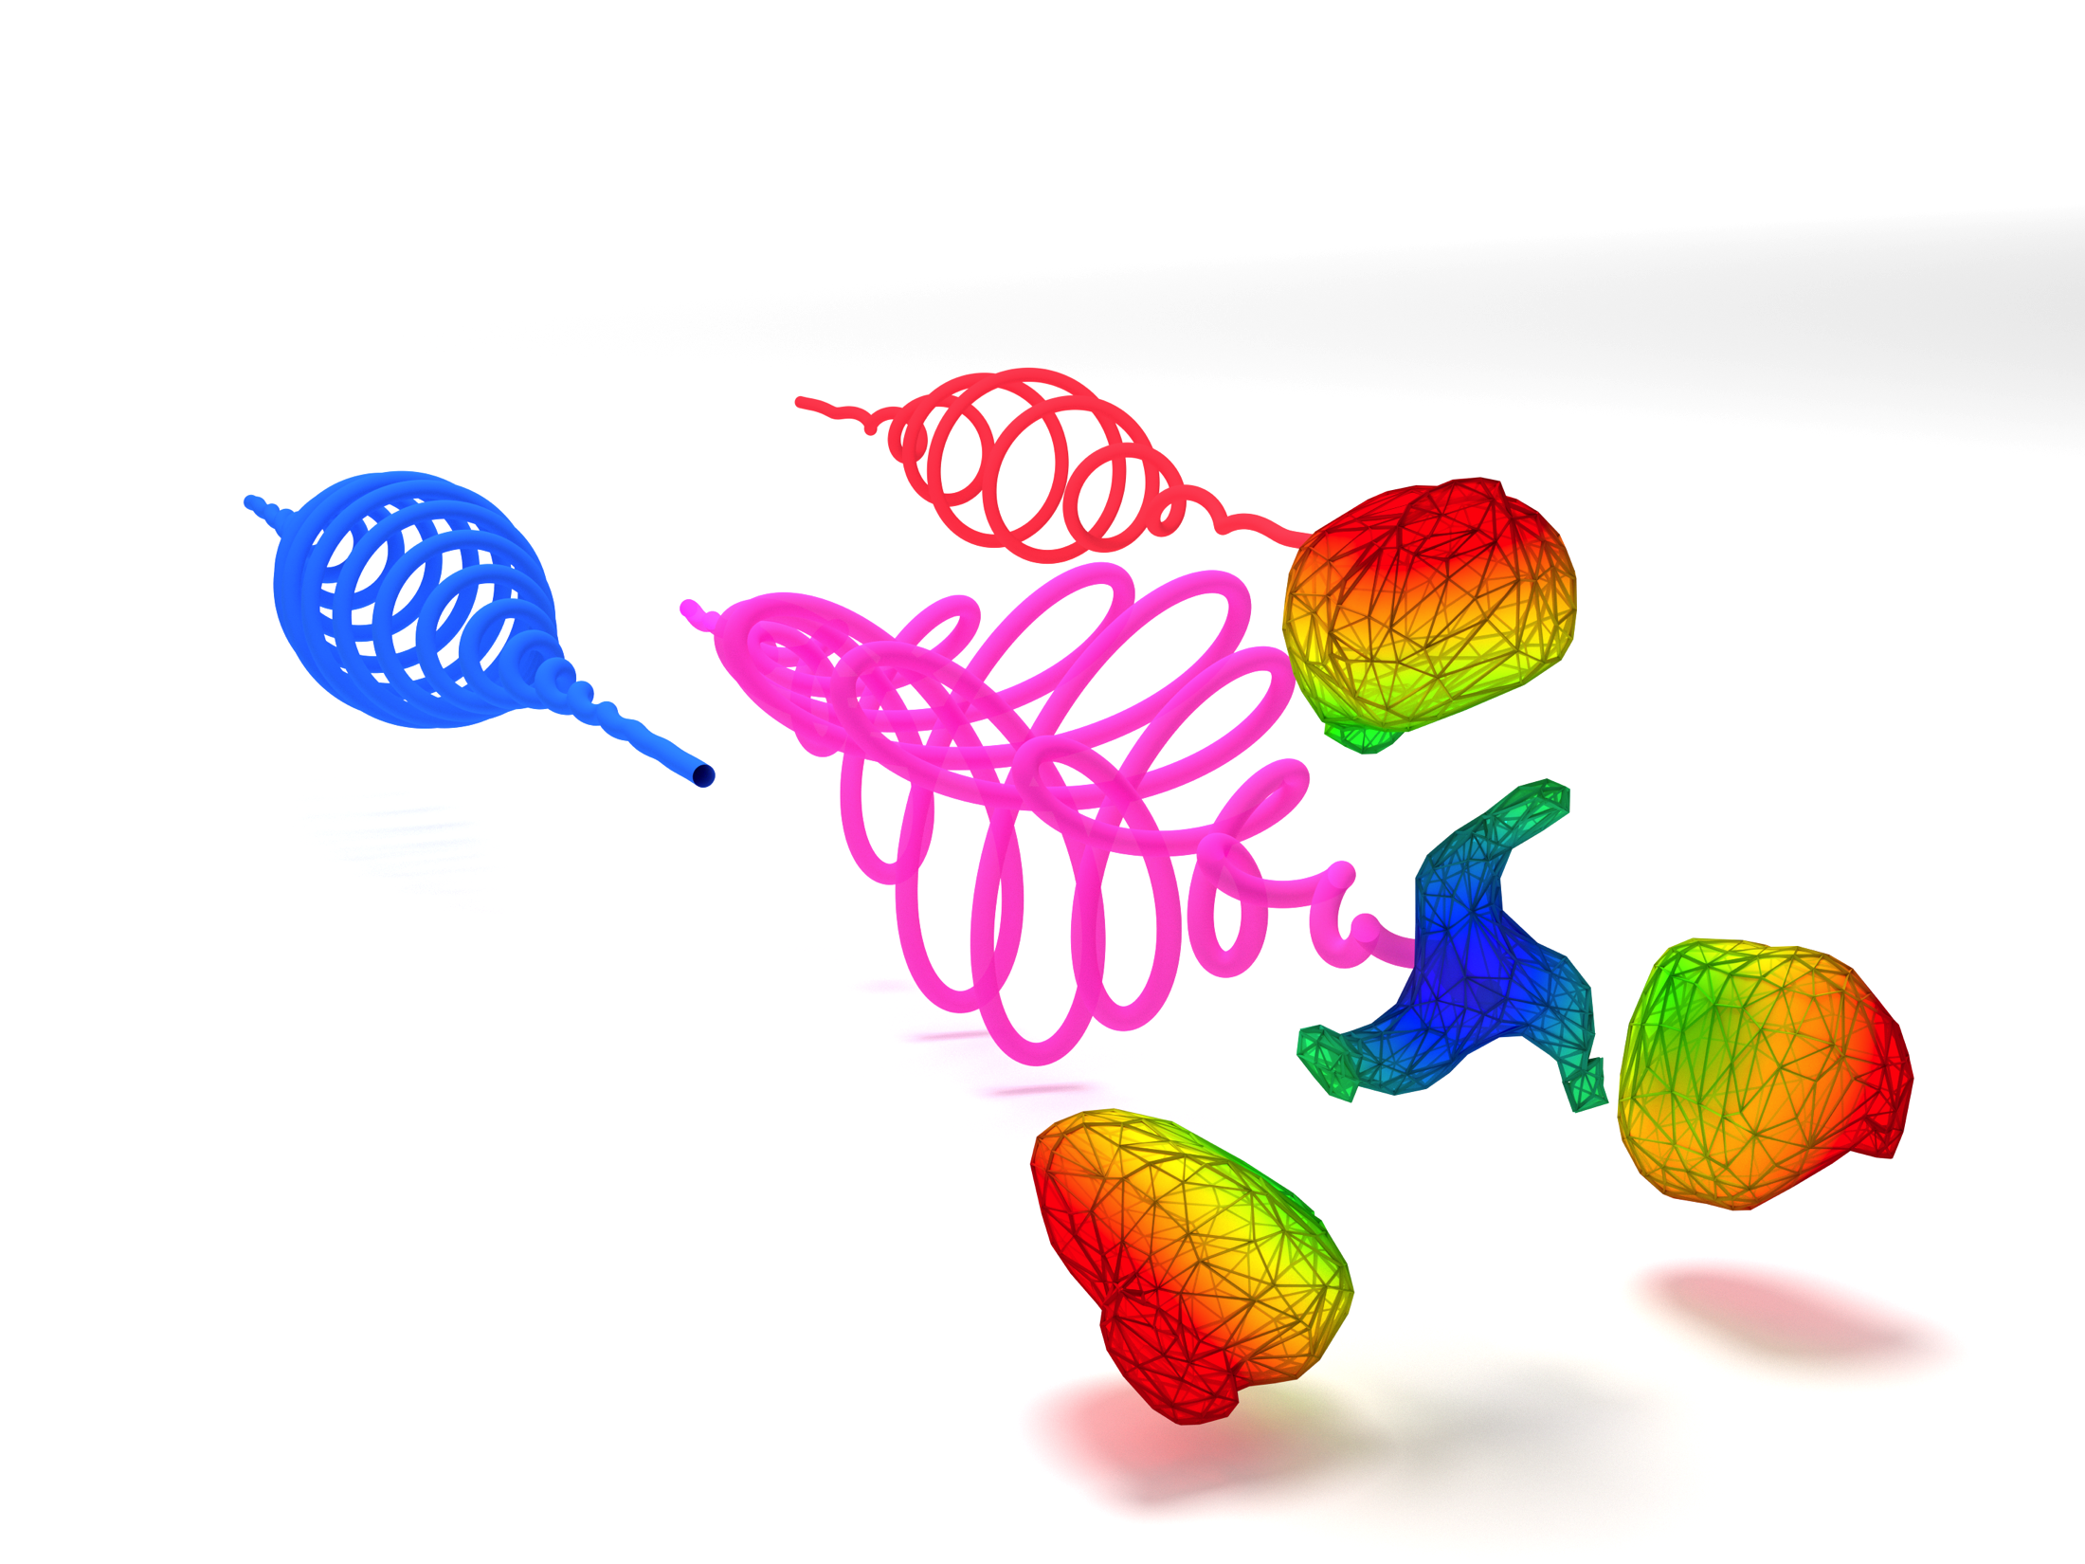

Strong-field physics in two-pulse circularly polarized laser fields
Daniel Hickstein
Chris Mancuso, Franklin Dollar, Jennifer Ellis, Carlos Hernandez-Garcia, Patrik Grychtol, Ronny Knut, Ofer Kfir, Xiao-Min Tong, Dmitriy Zusin, Christian Gentry, Emrah Turgut, Tingting Fan, Ming-Chang Chen, Avner Fleischer, Oren Cohen, Chip Durfee, Henry Kapteyn, and Margaret Murnane
Kapteyn–Murnane Group
JILA – University of Colorado
Notes:
Good afternoon and thank you all for coming to my talk. My name is Dan Hickstein and I work in the Kapteyn–Murnane group at the University of Colorado. Today I’m going to tell you about some of the exciting strong-field physics that takes place when atoms are irradiated with two-pulse circularly polarized laser fields.

Slide 2
Strong-field physics in two-pulse circularly polarized laser fields
Outline
Strong-field ionization in two-color circular fields
Circularly polarized HHG in the soft X-ray region
Noncollinear circular HHG
angularly isolated harmonics
isolated attosecond pulses with circular polarization
Notes:
Today I will tell you about three different aspects of this physics. First, I will discuss strong field ionization in two color fields. Next, I will explain how we can now extend circularly polarized HHG to the soft X-ray using mid-IR driving lasers. And finally, I will discuss how a noncollinear geometry can provide us with some very interesting new capabilities.

Slide 3
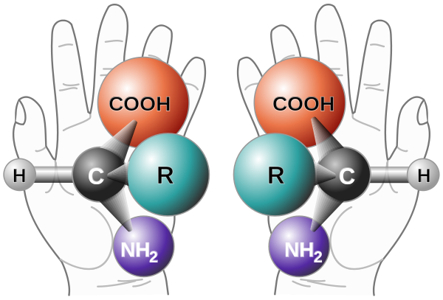
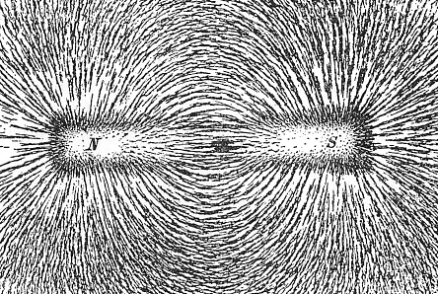
Circularly polarized HHG enables ultrafast circular dichroism measurements
Chiral molecules
Magnetic materials
X-ray magnetic circular dichroism
(XMCD)
Notes:
The practical motivation for studying strong-field physics in circularly polarized fields is so that we want to extend high harmonic generation to produce circularly polarized light. Circular polarized attosecond pulses are very useful for studying ultrafast processes in a number of systems, especially chiral molecules and magnetic materials. Efficient waveplates do not exist in the XUV, so strong motivation to generate circularly polarized harmonics directly from the HHG process.

Slide 4
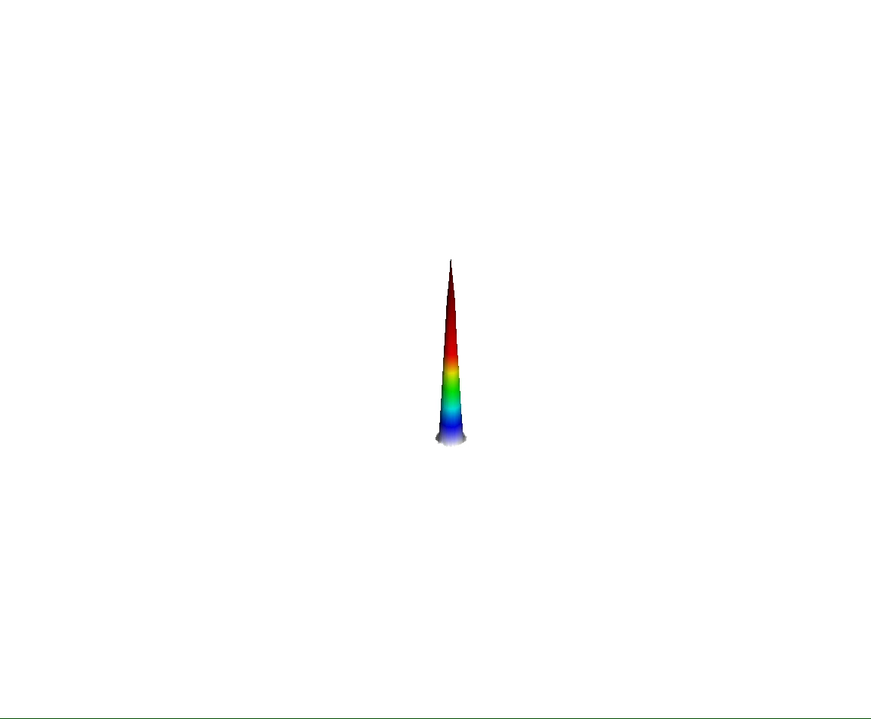
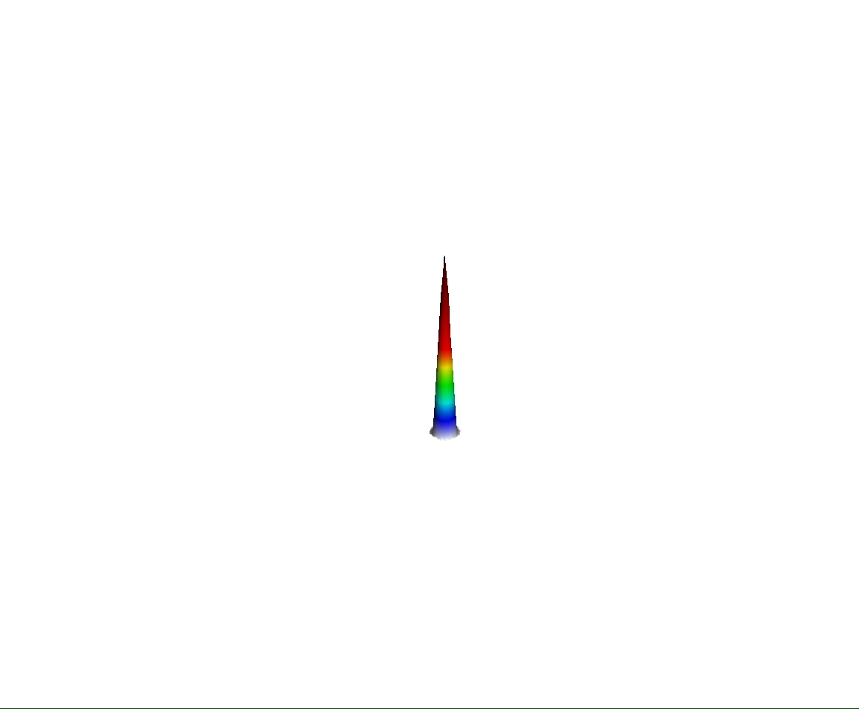

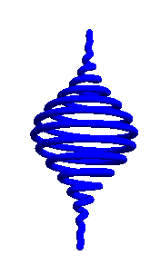
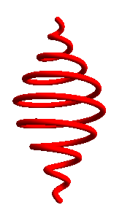
Two-color circular fields enable electron-ion scattering
Electron wavefunctions from TDSE simulations by Carlos Hernandez-Garcia
1-color linear
1-color circular
2-color counter-rotating
Movie from Carlos Hernandez-Garcia
PRA 51, R3414 (1995); PRA 52 2262 (1995)
Notes:
When we make harmonics in a linearly polarized field, the electron wavepacket is driven back and forth by the electric field, providing lots of opportunity for recollision and high harmonic generation.
Unfortunately, if a single circularly polarized field is used, the electron wavepacket is driven away from the ion and so we cannot directly generate circularly polarized harmonics by using a single circularly polarized laser pulse.
However, if two counter-rotating circularly polarized fields are mixed together, then the electron wavepacket is driven past the ion several times per laser cycle and circularly polarized high harmonics can be generated.

Slide 5
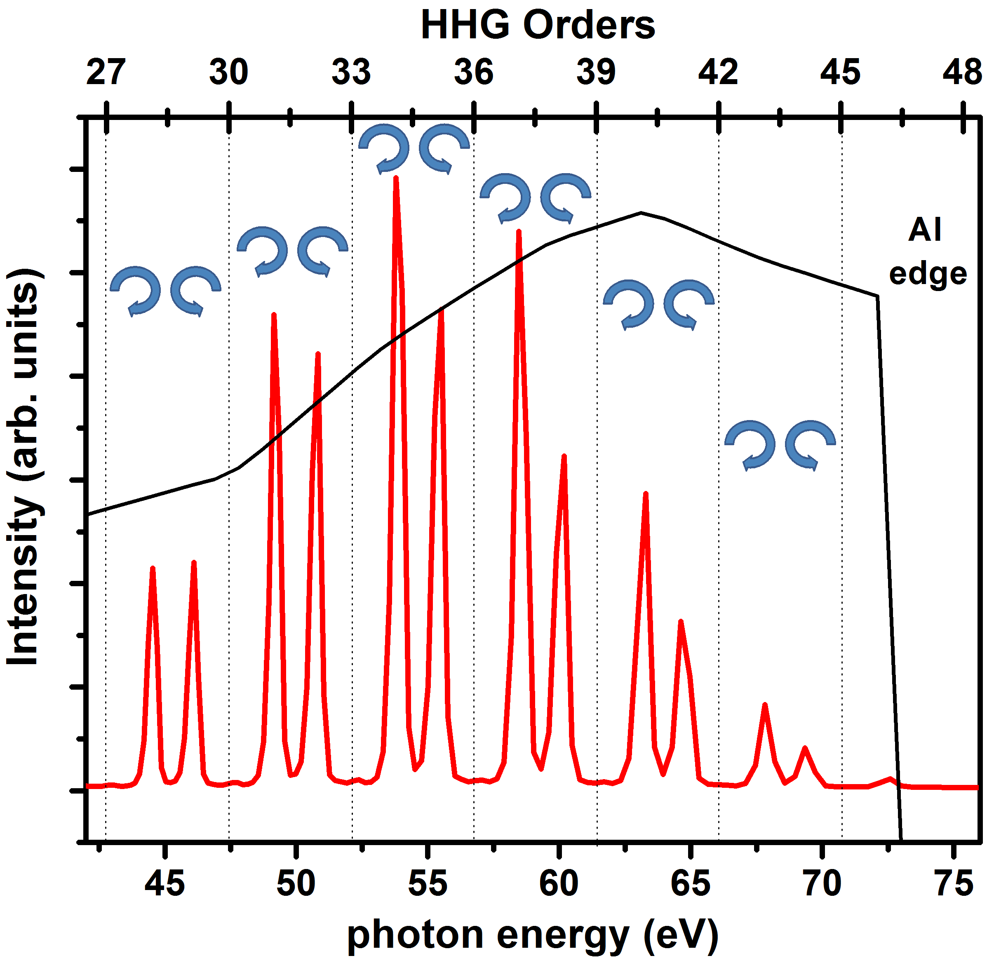
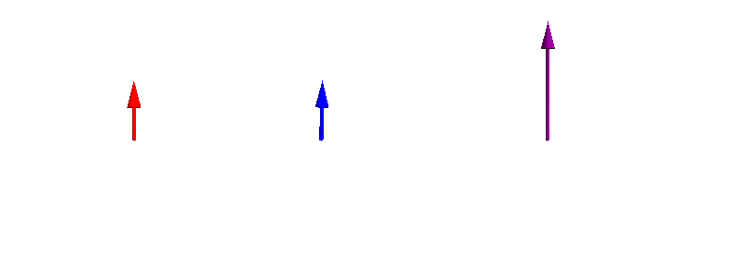
Circularly polarized HHG possible using two-color counter-rotating fields
ω
(800 nm)
2ω
(400 nm)
Combined field
Eichmann, H. et al. Phys. Rev. A, 51, R3414 (1995) Long, S. et al. Phys. Rev. A 52 2262 (1995)
Kfir, O. et al. Nat. Photon. 9, 99–105 (2015)
Fleischer, A., et al. Nat. Photon. 8, 543–549 (2014)
Notes:
While some preliminary studies of HHG in two-color circular fields were done 20 years ago, it was really Oren Cohen’s group that recently brought it to the world’s attention that we could mix an 800 nm left circularly polarized laser field with an 400 nm right laser field and generate high harmonics. The combined field has this three-fold symmetric cloverleaf shape, and the harmonic spectrum itself also displays an sort of three-fold symmetry where one order is left circularly polarized, the next order is right circular, and the third order is missing. This left right missing pattern continues through the harmonic spectrum.

Slide 6
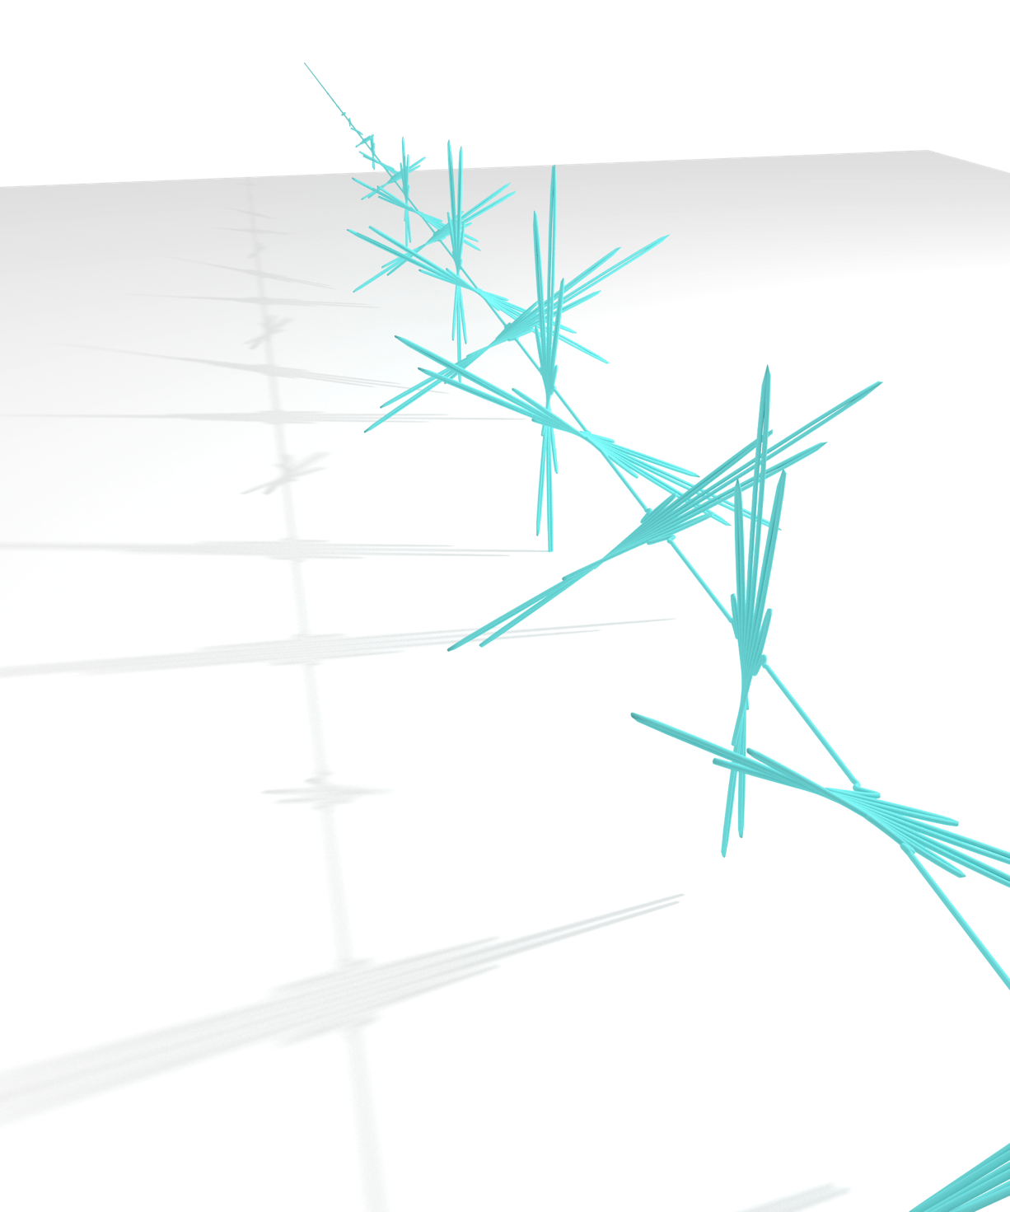
“Circularly polarized” attosecond pulse train
Linearly polarized attosecond bursts, rotated by 120 degrees
Time
Notes:
In the time domain, these circularly polarized harmonics manifest as an attosecond pulse train, consisting of attosecond bursts that are locally linear. But, each attosecond burst is rotated 120 degrees from the previous burst.
And, at first, this explanation seemed a little bit crazy, so we asked ourselves: is there a way that we can confirm this proposed mechanism of circular polarized high harmonic generation.

Slide 7
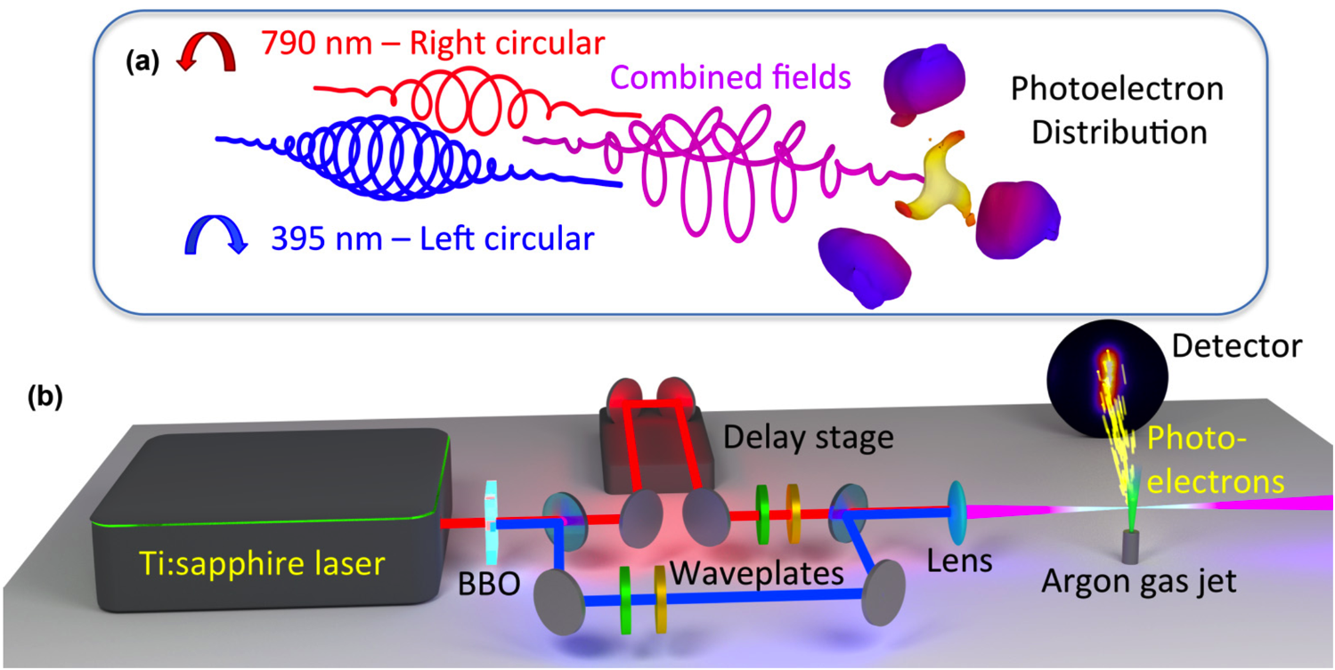
1. Strong-field ionization in two-color circular fields
Mancuso et. al., Phys. Rev. A 91, 031402(R) (2015)
Notes:
And yes, we can look at strong field ionization in these two-color circularly polarized field. Strong field ionization has provided a great deal of insight into strong-field dynamics in linealy polarized laser fields, and here we extend that to bichromatic circularly polarized fields.
And this is what the experiment looks like, we have a simple two-color interferometer, where we are interfering two circularly polarized laser pulses at 800 and 400 nm. We strong-field ionize argon gas, and record a projection of the photoelectron distribution using a velocity map imaging spectrometer. At first, this geometry seems very inconvenient, because the electric field and the resulting photoelectron distribution are oriented perpendicular to the detector. This means that we cannot apply the usual trick of assuming cylindrical symmetry to recover the 3D momentum distribution.

Slide 8
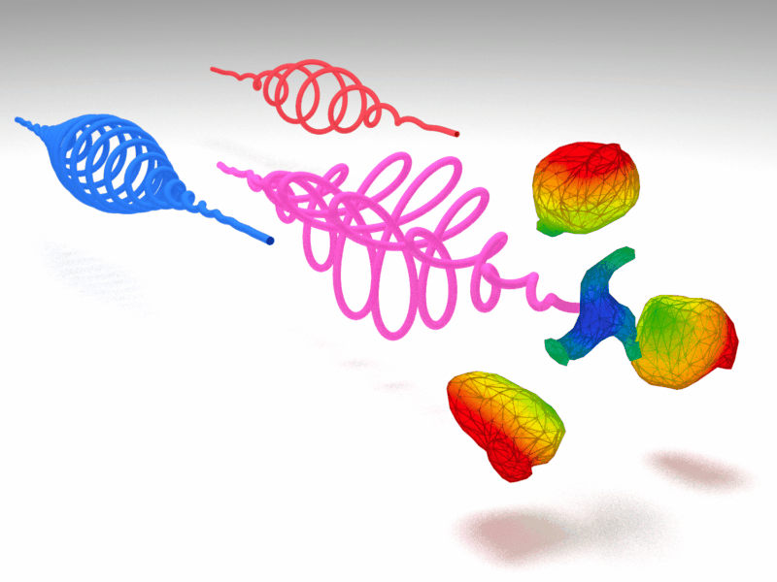
Rotation of field with time-delay allows tomographic reconstructions via inverse Radon transform
Tomographic reconstruction in VMI: Smeenk, C., et al. J. Phys. B 42, 185402 (2009).
Notes:
But, we can take advantage of the fact that changing the time delay between the 400 and 800 nm laser fields can be used to rotate the combined electric field as well as the generated photoelectron distribution. By recording the distribution at many different angles, we can apply the same tomographic reconstruction techniques that are used in medical imaging to produce a three-dimensional reconstruction of the photoelectron angular distribution. Specifically, we use the filtered back projection implementation of the inverse radon transform.

Slide 9
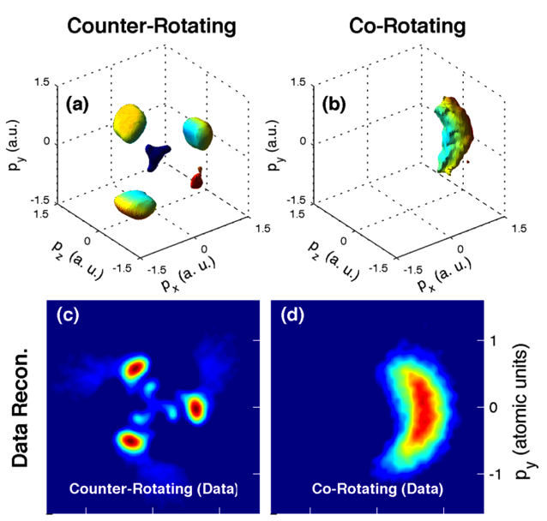
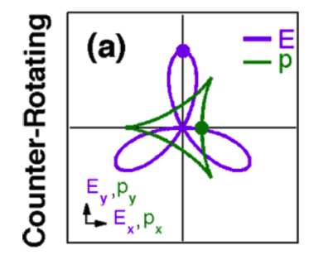
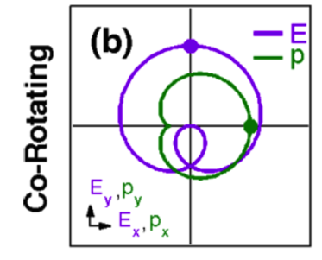
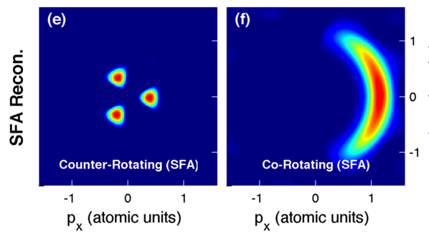

Tomographic reconstructions of photoelectron distributions in two-color circular fields
Notes:
And this is what the 3D momentum distributions look like. We performed the experiment twice, once for counter-rotating fields, where we expect the electron wavepacket to be driven back to the ion, and once for co-rotating fields where we expect that the electron wavepacket will be driven away from the ion. For counter-rotating fields, we have this three-lobed distribution, which correspond to ionization that takes place at the peak of the three different field maxima. In co-rotating fields, we have one broad lobe which corresponds to electrons ionized during the one maxima of the electric field.
Here we look at 2D projections of the 3D momentum distribution, and it makes it a little easier to visualize the features. And we can compare these experimental results to what we would expect from a simple strong field model that takes into account the electric field of the laser, but ignores the coulomb potential. For the co-rotating fields, the model agrees with the experiment very well. However, for the case of counter-rotating fields, we notice that there are low energy structures that are not seen in the model. So, this makes us us think that these features may be due to the electron wavepacket interacting with the Coulomb potential.

Slide 10

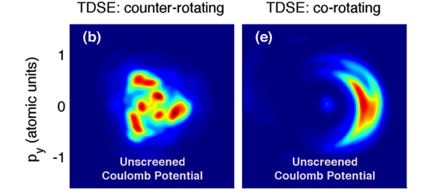
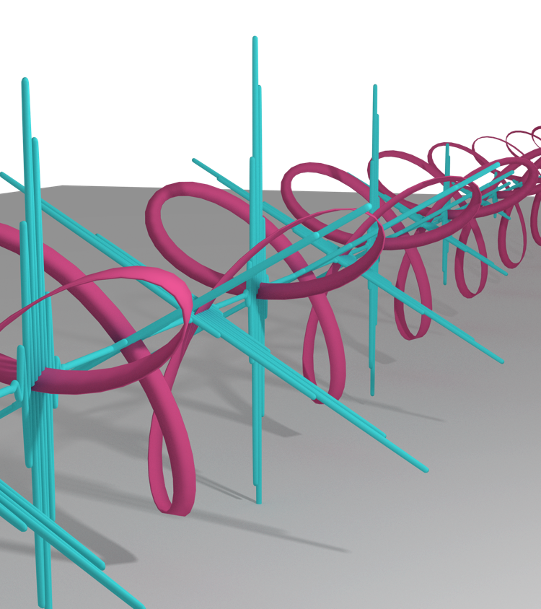
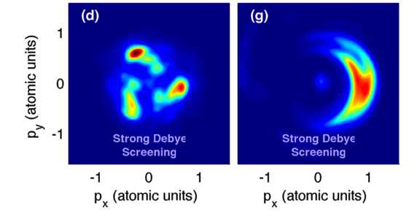
TDSE Reveals role of Coulomb potential
TDSE calculations by Prof. Xiao-Min Tong, Tsukuba University, Japan
Notes:
And this theory is confirmed when we look at the photoelectron distributions simulated using the time-dependent schrodinger equation. The top row here shows the photoelectron distribution with the normal Coulomb potential, which agrees well with the experiment. The bottom row shows the photoelectron distributions where where the long-range Coulomb potential has been attenuated. As you can see, the low energy structures are very sensitive to the Coulomb potential and basically disappear when the Coulomb potential is attenuated, demonstrating that they result from the electron wavepacket scattering from the Coulomb potential.
And these results give us some insight into the high harmonic generation process. Not only do we clearly see the three fold symmetry of the pulse train mirrored in the three-fold symmetry of the photoelectron distribution, but we also see clear evidence of the electron wavepacket interacting with the Coulomb potential, which is the process that allows the harmonics to be generated.

Slide 11
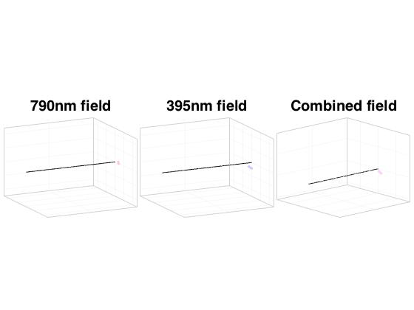
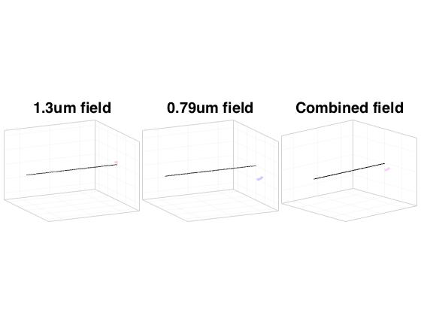
2. Circularly polarized HHG from noncommensurate driving lasers
Commensurate lasers: ω + 2ω
Non-commensurate lasers:
0.8µm + 1.3µm
(ω + 0.615ω)
Notes:
So, now that we have some confidence in the physics of circularly polarized high harmonic generation, we can ask the question: how can we improve the circularly polarized HHG process.
And one way that we can improve the process is to relax this requirement that we need to mix the fundamental and second harmonic. Specifically, we want to reach higher photon energies by mixing the fundamental with the 1.3 micron output of an OPA – wavelengths that are not integer multiples of one another.
But what do the electric fields look like? For w + 2w, we know that the field traces out a beautiful repeating cloverleaf shape. However, when we mix 800 and 1.3 micron, we get a much more chaotic field. And we might expect that this field will not be capable of generating circularly polarized harmonics.

Slide 12
Circularly polarized soft X-ray HHG driven with non-commensurate infrared lasers
800 nm + 1300 nm
Notes:
But the symmetry, or lack of symmetry of the combined field actually does not matter for high harmonic generation. The process is robust, and the selection rules ensure that circularly polarized harmonics are generated even when the wavelengths are not integer multiples of one another.
As you can see, we can generate beautiful circularly polarized harmonic from a combination 800 and 1.3 micron. And reach photon energies in excess of 150 eV.
The interesting thing here is that we see a slightly different spectral structure of the circularly polarized harmonics. Instead of the left right missing pattern, we have doublets consisting of two harmonics of the opposite helicity. The doublets are spaced by the sum of the photon energies and each doublet is split by the difference in photon energies. The left-right-missing pattern is just one specific case of this general behavior.

Slide 13
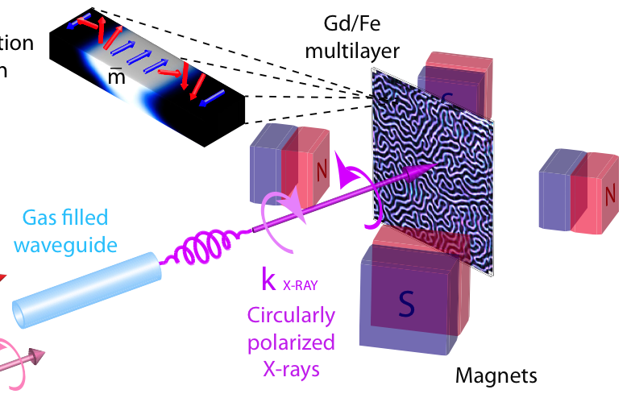
X-ray magnetic circular dichroism first XMCD at the Gd M-edge
1st measurement of XMCD for Gd N edge (145eV)
FeGd multilayer is an all-optical magnetic switching material
Notes:
And these higher energy circularly polarized harmonics are very useful, because they allow us to probe the absorption edges in several interesting magnetic materials, including the Gadolinium N edge in this iron gadolinium multilayer sample.
In this experiment, we switched the magnetic state of the material by rotating permanent magnets around the sample, and by comparing the absorption of the sample with different orientations of the magnetic field, we can calculate the X-ray magnetic circular dichroism. This measurement not only confirms the alternating helicity of the harmonic orders, but it is actually the first measurement of the magnetic circular dichroism at the Gadolinium N edge.

Slide 14

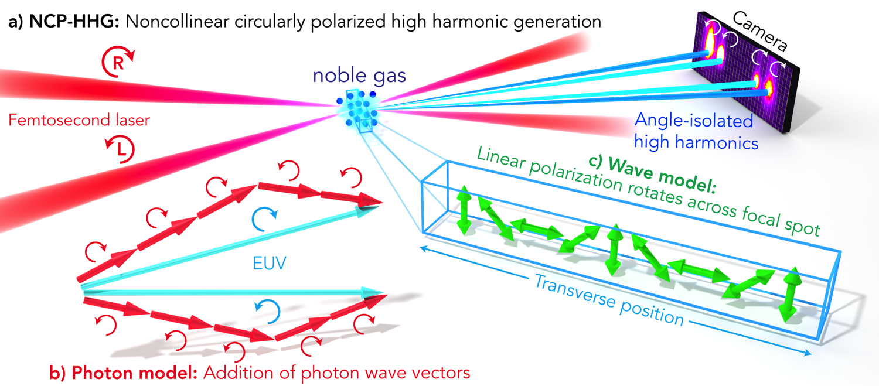
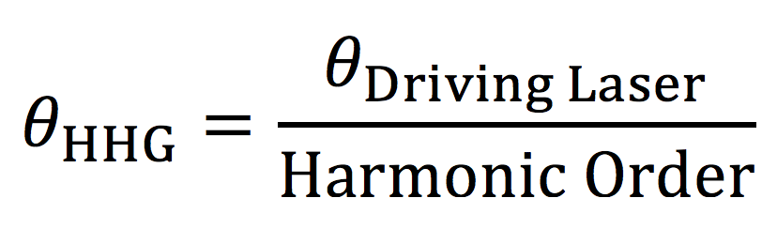
3. Noncollinear circularly polarized HHG
Hickstein et. al., Nature Photonics. In Review (2015)
Notes:
But then we started wondering: is it possible generate circularly polarized harmonics using only one wavelength of driving laser? And the answer is yes, and all it takes it for the two beams to be crossed in a noncollinear geometry.
This makes sense in a photon picture: we can absorb n photons from one beam, n plus or minus one photons from the other beam and, by the conservation of momentum, we find that all of the left circularly polarized harmonics go to the left and all of the right circular harmonics go to the right.
If you think about the interference of two circularly polarized beams, at first it seems like the two beams should just mix to yield linear polarization and you would just generate linearly polarized harmonics. And this is almost what happens, the beams mix to provide linear polarization, but the linear polarization rotates as a function of the transverse position in the laser focus. And this leads to something that look like a grating structure. This “polarization grating” creates two diffracted orders, one with left circular polarization and one with right circular polarization. And, since this is a purely sinusoidal grating, there is actually no zero order.
And, a bit like a grating, the angle of the emitted harmonics is just given by the crossing half angle of the two driving laser beams divided by the harmonic order. So if we look at low order harmonics with a high crossing angle, we should be able to separate the different harmonic orders without a grating.

Slide 15
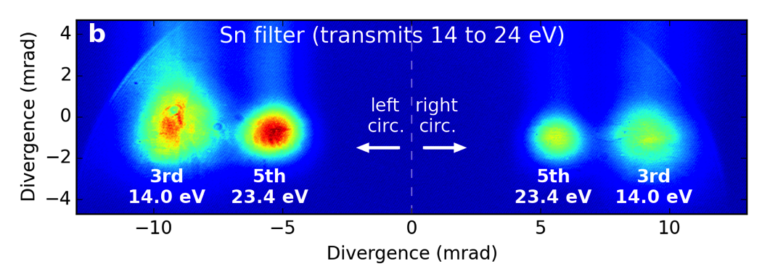
NCP-HHG with 267+267 nm Angularly separated harmonics
(in Argon gas)
Notes:
And this is exactly what we see when we drive the process with two circularly polarized pulses at 267 nm. Here we see two harmonics in the VUV region that are well separated from one another. The harmonics on the left are left circularly polarized and the harmonics on the right are right circularly polarized. And this is the raw CCD image. And we do not need to use a spectrometer to resolve the different photon energies, because they are angularly separated.
However, since each of these beams consists of only one harmonic, we no longer have and attosecond pulse train. These pulses have durations of many femtosecond. And that is not really appropriate for this attosecond conference.

Slide 16
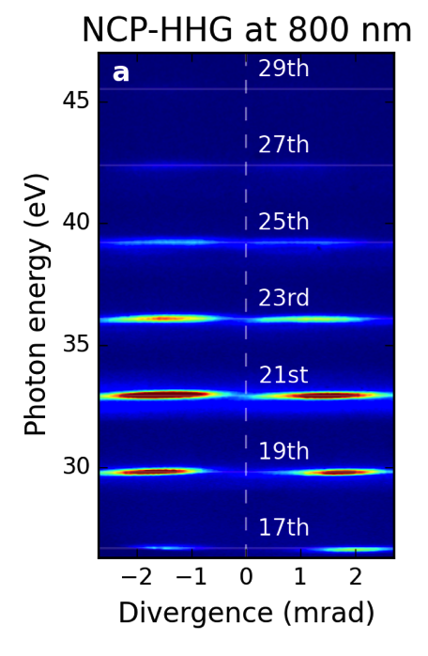
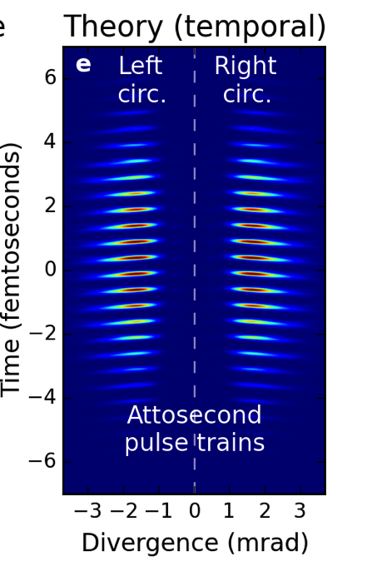
NCP-HHG with 800+800 nm Attosecond pulse trains
(Argon gas)
Notes:
But, attosecond pulses are also possible using the noncollinear method. For example, here is the result of noncollinear circularly polarized HHG using 800 nm driving lasers. Since the harmonics orders are overlapped, we used a spectrometer to disperse them in this direction.
You can see that each harmonic order is emitted at a slightly different angle, but since the harmonics are still mostly overlapped, we generate the familiar attosecond pulse train which has proven very useful for many experiments. And I should emphasize here that each pulse train consists of attosecond bursts with simple circular polarization. This is not the rotating linearly polarized pulse train.

Slide 17
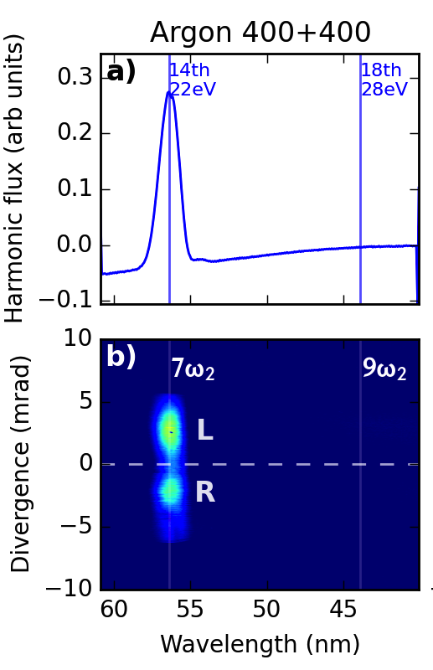
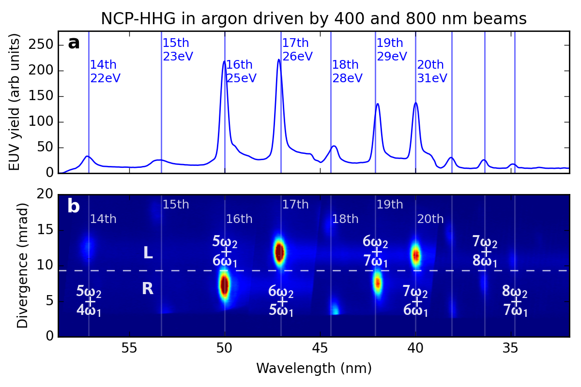
400 + 400 nm High flux single harmonic
400 + 800 nm
Reveals additional channels
~10⁸ photons/pulse
(comparable to single-beam HHG)
Notes:
And we can play many of the same tricks that we can with single beam HHG. For example, can use 400 nm driving lasers to easily achieve a single harmonic with high intensity. We estimate that this is somewhere around 10^8 photons per pulse, which is similar to single-beam driven HHG, and so it should be bright enough for many applications.
And we can actually use whatever wavelengths that we like in order to customize our flux and photon energy. For example, we can use 400 + 800 nm driving lasers, which provides bright harmonics with the familiar left-right-missing structure that we saw in collinear two-color HHG. If you look very closely here, you can see some additional harmonics that are forbidden by selection rules, but are seen because the fields are not perfectly circular, they are actually slightly elliptical. In the collinear HHG experiment, we cannot resolve the different channels that create this harmonic. But since the noncollinear method angularly disperses the beams according the the number of pump photons absorbed from each beam, we can see that this peaks is actually composed of two pathways leading to the same photon energy.
Interestingly, even though these channels are a result of the ellipticity of the driving laser beams, they are should also circularly polarized with opposite helicities.

Slide 18
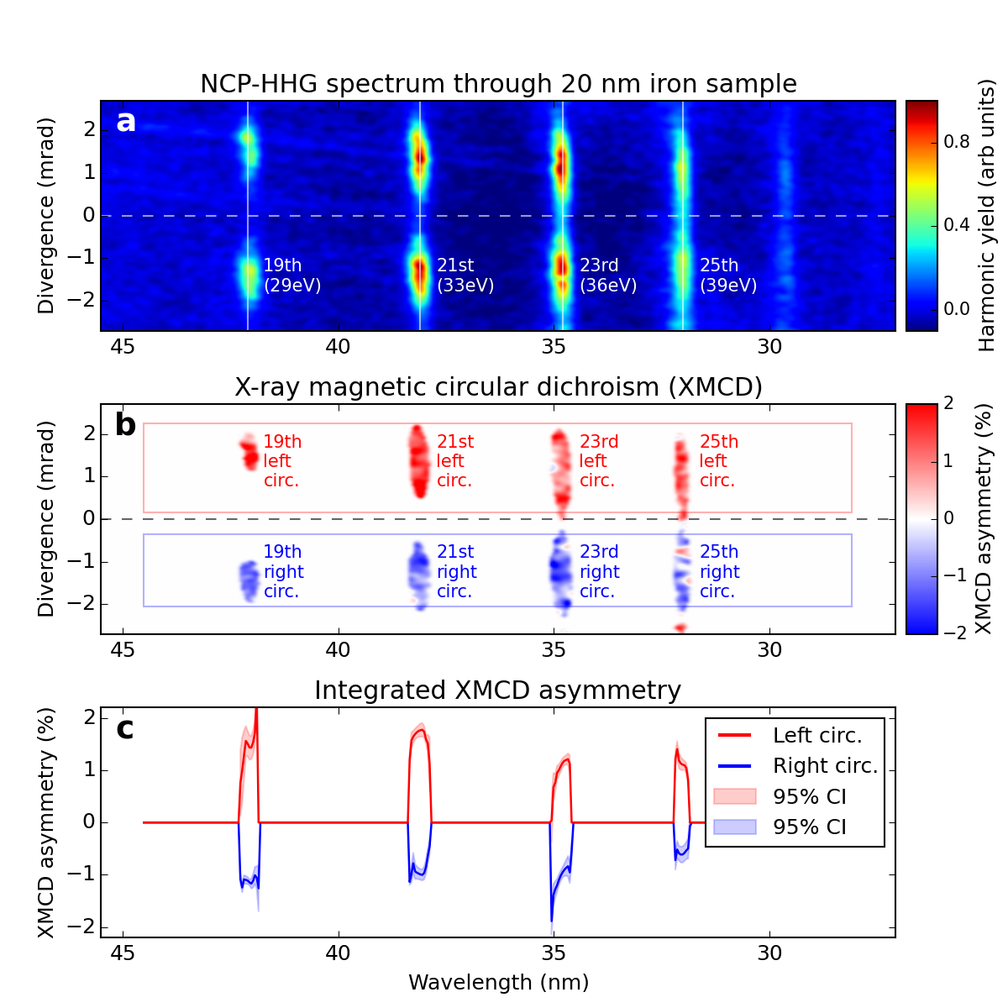
XMCD of iron sample confirms helicity of harmonics
Wavelength (nm)
Notes:
In order to confirm the circular polarization of each harmonic, we performed an X-ray magnetic circular dichroism measurement on a 20 nm thick iron sample. In this experiment, we applied a magnetic field with an electromagnet and compared the transmission of the sample the field pointing in opposite directions.
Here is the transmission of the harmonics through the sample, and below is the magnetic circular dichoism. As you can see, in one direction the harmonics are all left circularly polarized, and in the other direction, the harmonics are all right circularly polarized.

Slide 19
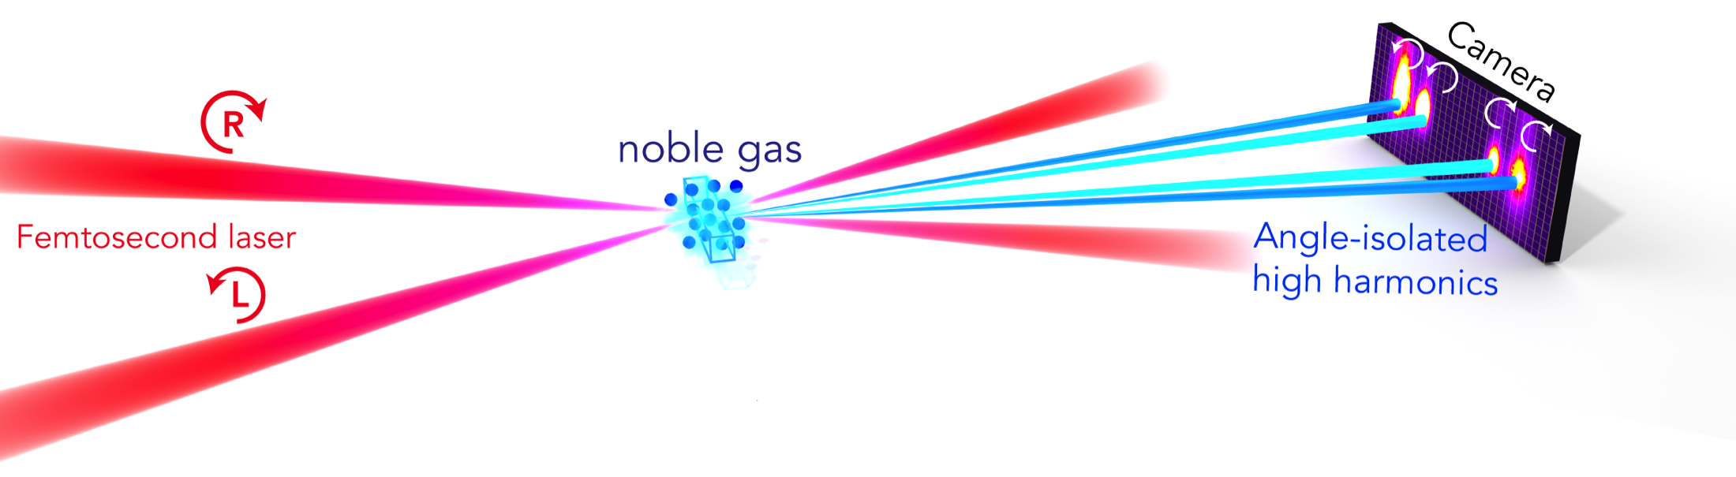
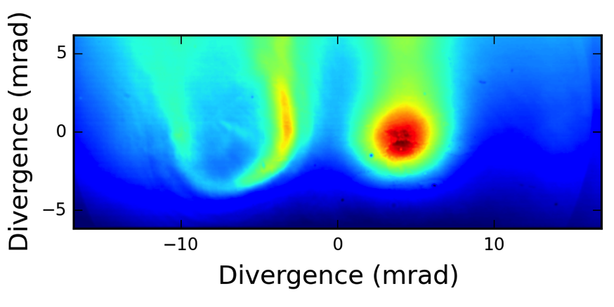
Noncollinear CP HHG
sample
Circular harmonics with any wavelength
Even identical wavelengths
Left and right circular at the same energy
Separation of harmonics
Spectroscopy without a spectrometer
Separation of HHG from driving lasers
Notes:
This noncollinear circularly polarized high harmonic generation technique offers some interesting possibilities for application experiments. It allows circularly polarized harmonics to be generated with seemingly any wavelength (even identical wavelengths). Left and right circular harmonics are produced with the same energy, which allows for a direct comparison. You can separate the harmonics to do spectroscopy without a spectrometer.
And we can separate the harmonics from the high intensity pump beam, which allows a sample to be placed immediately after the interaction region without fear of damage. Here we placed an 80 micron diameter biological sample (actually one of my hairs) only 1 centimeter past the interaction region we were able to completely block one of the harmonic beams without the sample being damaged by the pump lasers. This demonstrates the ability of this method to probe a sample with high-flux XUV light without any additional optics. So you can easily imagine doing a spectroscopy experiment without filters, focusing optics, or even a grating.

Slide 20
Isolated attosecond pulses with circular polarization
Notes:
Lastly, I would like to talk about how we might go about generating an isolated attosecond pulse with circular polarization.
As I showed previously, when we use collinear bichromatic fields to generate circular harmonics, the generated pulse train consists of pulses that look locally linear. If we were to isolate one of these pulse, it would just look like a linearly polarized laser pulse.

Slide 21
Isolated attosecond pulses with circular polarization
SFA+ calculations by Carlos Hernandez-Garcia
Notes:
And this is exactly what the simulations suggest happens if we drive the process with very short laser pulses. For the two-color collinear geometry, we simply get a pulse that looks more-or-less linear.
In contrast, the noncollinear method generates a pulse train of truly circularly polarized attosecond pulses. If we drive the process with few-cycle driving lasers, we can generate an isolated circularly polarized attosecond burst.

Slide 22


Summary
Two-color fields:
Allow robust electron–ion rescattering
Circularly polarized HHG from the VUV to soft X-ray
Noncollinear geometry:
Angularly isolated harmonics
Practical generation of circularly polarized isolated attosecond pulses
Acknowledgements
JILA - University of Colorado
Colorado School of Mines: Chip Durfee
Chris Mancuso
Jennifer Ellis
Franklin Dollar
Tingting Fan
C. Hernandez-Garcia
Patrik Grychtol
Ronny Knut
Dmitiy Zusin
M. Gopolakrishnan
Christian Gentry
Ming-Chang Chen
Tenio Popmintchev
Margaret Murnane
Henry Kapteyn
U. of Tsukuba, Japan: Xiao-Min Tong
Technion, Israel:
Oren Cohen
Ofer Kfir
Avner Fleischer
Notes:
To summarize, two color fields allow for electron-ion rescatteing with a variety of driving laser wavelengths and can be used to generate circularly polarized harmonics from the VUV to soft X-ray regions.
Also, a noncollienar geometry can be used to generate angularly isolated harmonics and may be the most practical method for generating isolated attosecond burst with circular polarization.
Thanks to funding from NSF and DOE and big thanks to all of my labmates and collaborators around the world.

Slide 23

Thank you! Questions?
Notes:
So, thank you for your attention, and I would be glad to take any questions or comments.

Slide 24

VMI spectrometer

Slide 25
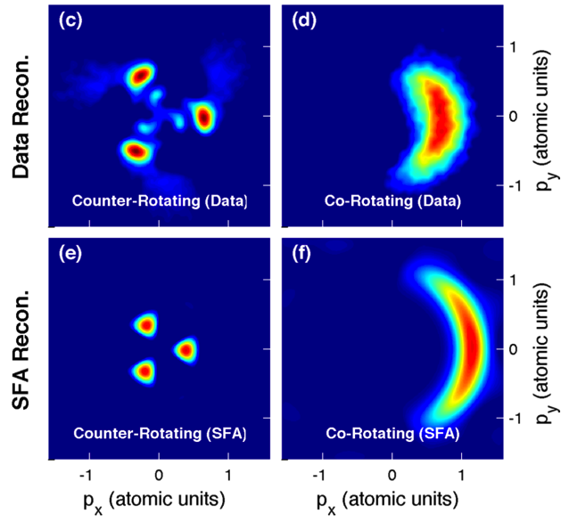
Strong-field approximation Only produces some structures
Notes:
When we compare the experimentally retrieved distributions to what we expect from a strong-field model, we notice that the agreement is generally good, except that the simple model completely fails to reproduce the structures that are seen in the low energy center of the counter-rotating distribution. So, we immediately have an intuition that these features are a result of the Coulomb potential of the ion, which the strong field model does not take into account.

Slide 26
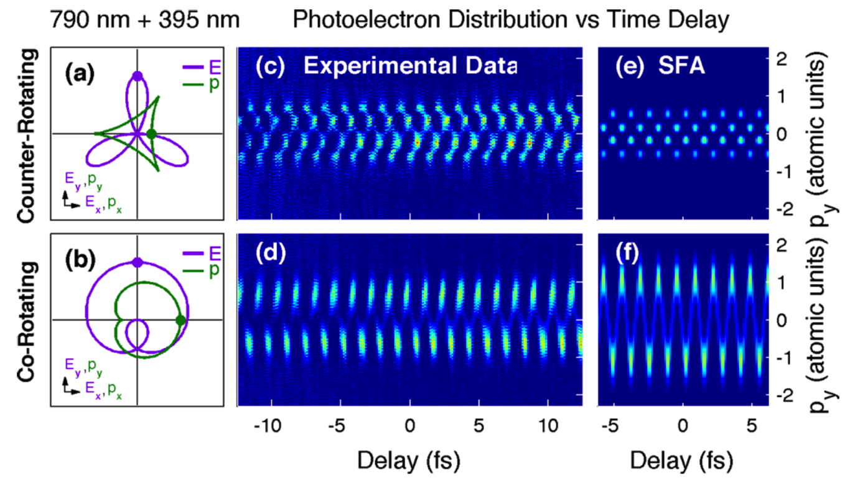
Photoelectron distribution changes with time-delay
Notes:
Here I’m showing just a one-dimensional projection of the photoelectron distribution, and you can see that it fluctuates with the periodicity of one 400 nm cycle. And you can see also that when we switch the fields to be co-rotating, the behavior is completely different. And, to a first approximation, these patterns are exactly what you would expect by applying a simple strong-field approximation model to the generated laser fields.
But, we don’t need to be content with this weird abstraction of the 3D data. We are taking many projections of the 3D photoelectron distribution at different angles, and this is the same thing that is done during an computer assisted tomography x-ray scan at a hospital. We can use the same tomographic reconstruction techniques in order to retreive the full 3D photoelectron momentum distribution from the 2D projections.

Slide 27
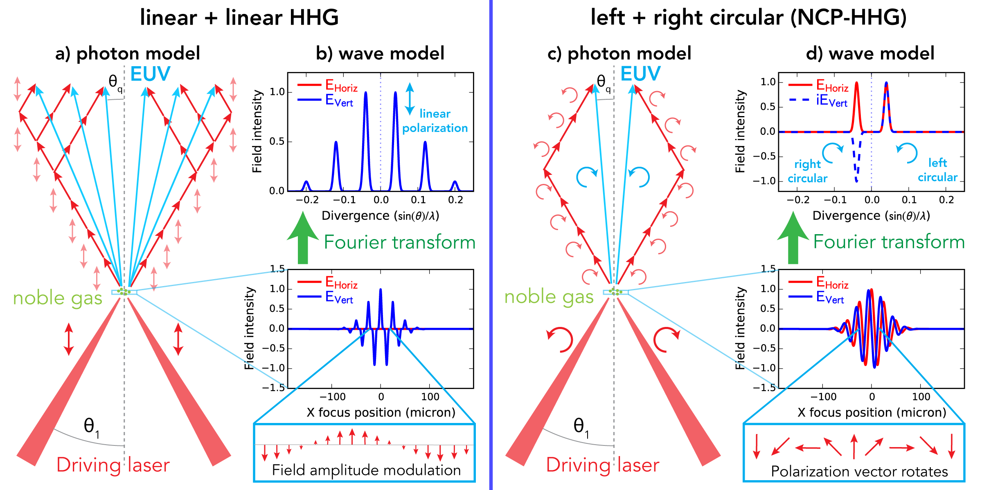
NCP-HHG photon and wave models
Notes:
And this slide compares the case of two linearly polarized beams mixing with two counter-rotating circularly polarized beams mixing. In the linearly polarized case, the only selection rule is that the total number of photons absorbed must be odd. And here I’m showing all of the different photon combinations that result in generating the 7th harmonic. We can draw the same picture for the other harmonics, and the end result is that you have a whole mess or harmonics all on top of one another and being emitted at different angles. And you can see the same thing in the wave picture. Since we have a nonlinear amplitude modulation across the laser focus, then we have many diffracted peaks in the far field.
In contrast, in the case of circularly polarized fields, the conservation of spin angular momentum imposes another selection rule: that the number of photons from one beam must be equal to the number of photons absorbed from the other beam, plus or minus one. So, we end up with just two beams for each harmonic order. One left circularly polarized and one right circularly polarized. In the wave picture we have a polarization that rotates across the laser focus and we get circularly polarized beams.

Slide 28
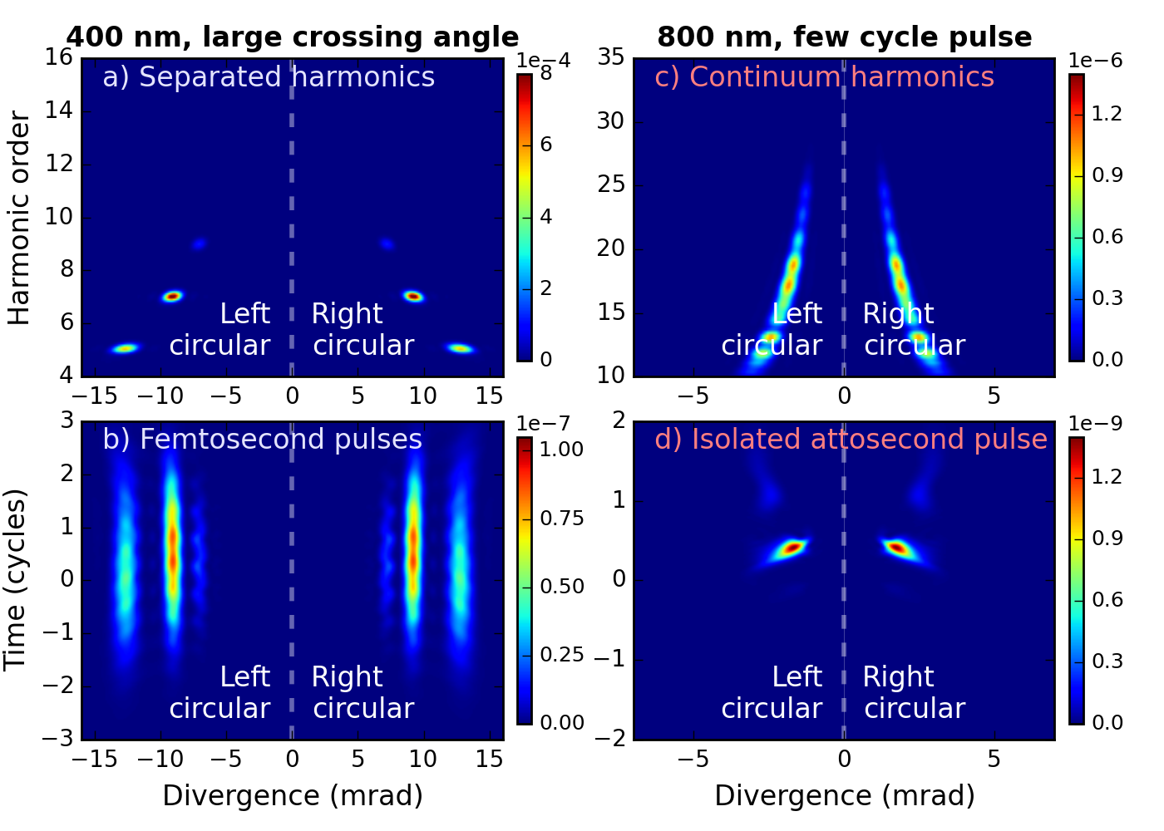
TDSE simulations
Numerical simulations by Carlos Hernandez-Garcia, JILA
Notes:
Numerical simulations demonstrate several additional capabilities of this technique that we have not yet demonstrated experimentally. First, with both 400 and 800 nm light and sufficient pressure in the interaction region, we should be able to separate the harmonics orders. Of course, separated harmonics in the time-domain are long pulses.
Additionally, just like in single-beam HHG, if very short driving laser pulses are used, we can generate isolated attosecond pulses. Importantly, since the pulse trains generated by the noncollinear method exhibit simple circular polarization, in contrast the the weird rotating linear polarization of the collinear generation method, the isolated attosecond pulses will still be circularly polarized.

Slide 29
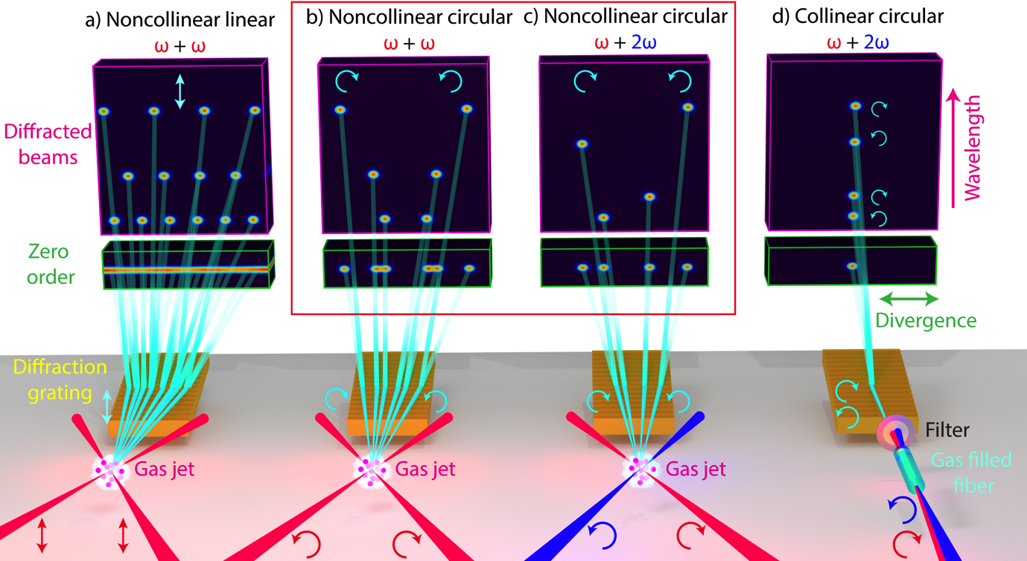

Slide 30
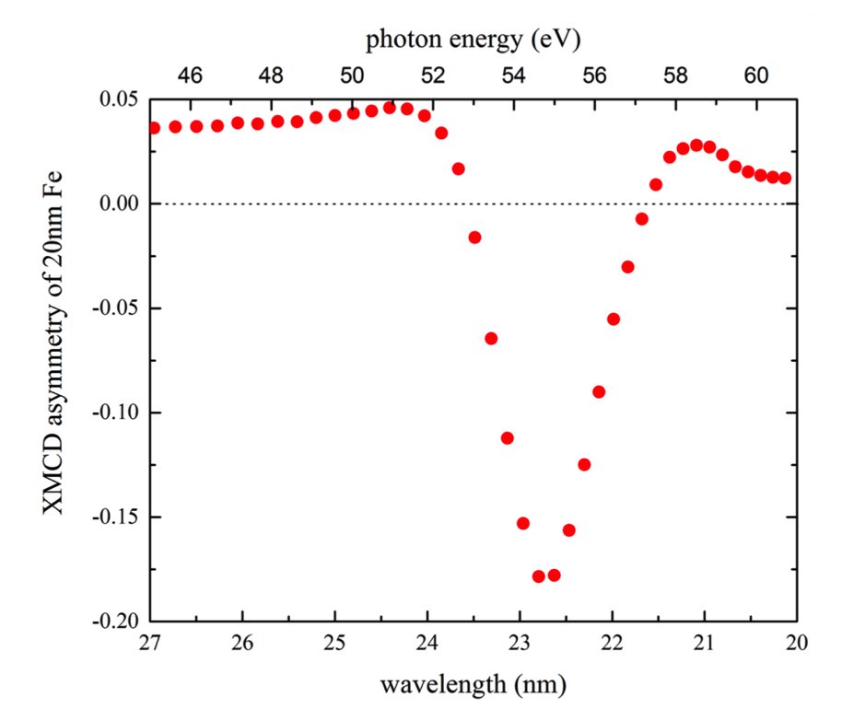
Synchrotron XMCD asymmetry

Slide 31
XMCD of iron sample
Notes:
In order to confirm the circular polarization of each harmonic, as well as to demonstrate that the noncollinear source was bright enough for actual applications, we performed an X-ray magnetic circular dichroism measurement on a 20 nm thick iron sample. Here is the transmission of the harmonics through the sample, and here is the XMCD signal in the regions where we had harmonic flux.
The XMCD asymmetry is in the range of a few percent, which is where we expect it should be from synchrotron measurements at slightly higher photon energies. So this confirms that the light we are actually generating experimentally is at the least highly elliptical, and probably completely circularly polarized.

Slide 32
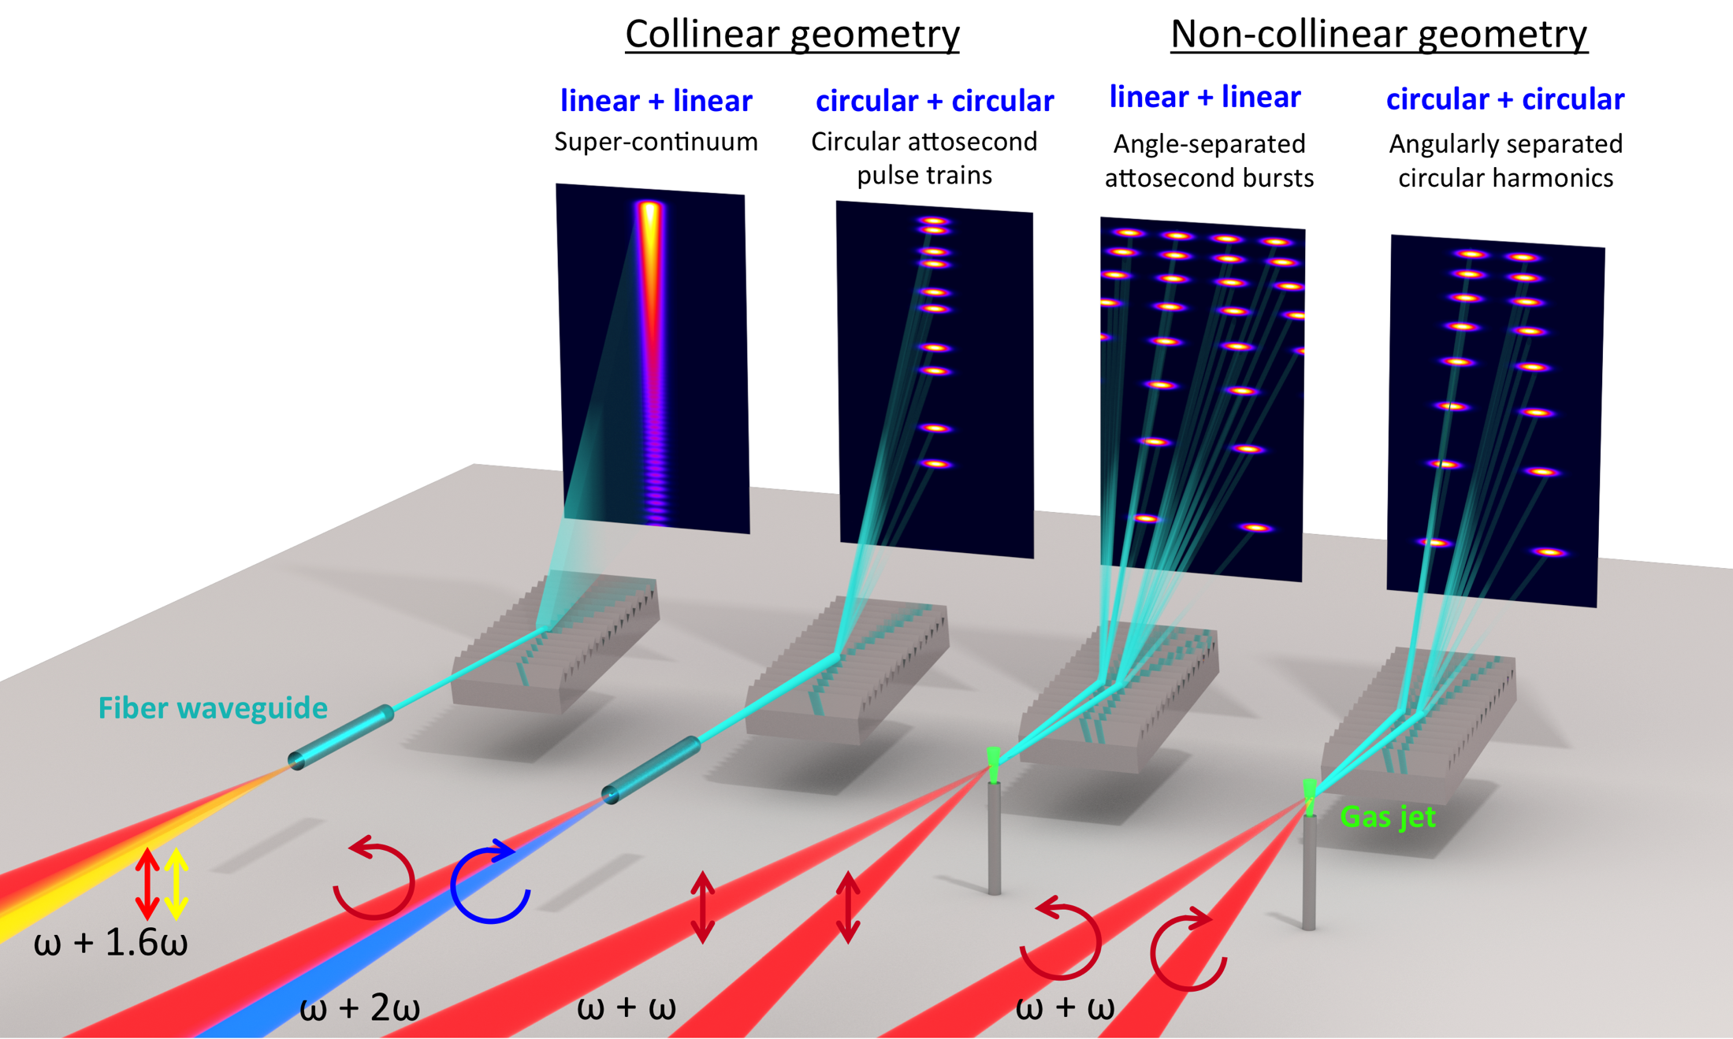

Slide 33

Notes:
First I will present some of the first experimental results of strong field ionization in two color fields. I’ll also tell you about two recent breakthroughs in the generation of circularly polarized high harmonics one of these is the generation of circularly polarized harmonics in the soft X-ray region, and the other is the generation of circularly polarized harmonics in a noncollinear geometry. Finally, I’ll briefly discuss how this noncollinear geometry may be the key to generating isolated attosecond pulses with circular polarization.

Slide 34
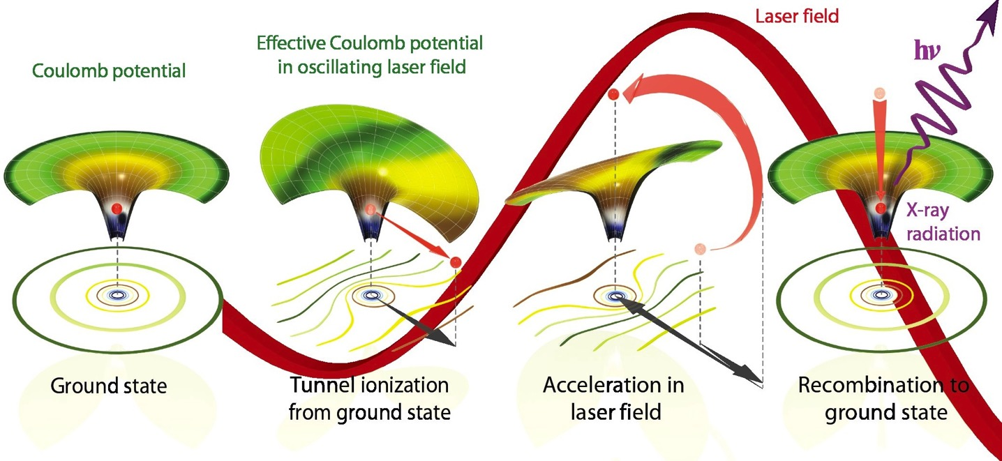
High harmonic generation typically driven by linear fields
STEP 1 STEP 2 STEP 3
Single circularly polarized pulse → No recombination → No HHG
Notes:
We often describe the process of high harmonic generation using a three-step model, where the electron is tunnel ionized from the atom, accelerated in the laser field, and then driven straight back to the ion, releasing its kinetic energy in the form of a high-energy photon.
In a circularly polarized laser field the electrons that are ionized are driven away from the ion and do not return. So, for many years, it was considered impossible to generate circularly polarized light using the high harmonic generation process. A lot of us were very sad about this, because circularly polarized EUV light is very useful for studying chiral molecules and magnetic materials.

Slide 35
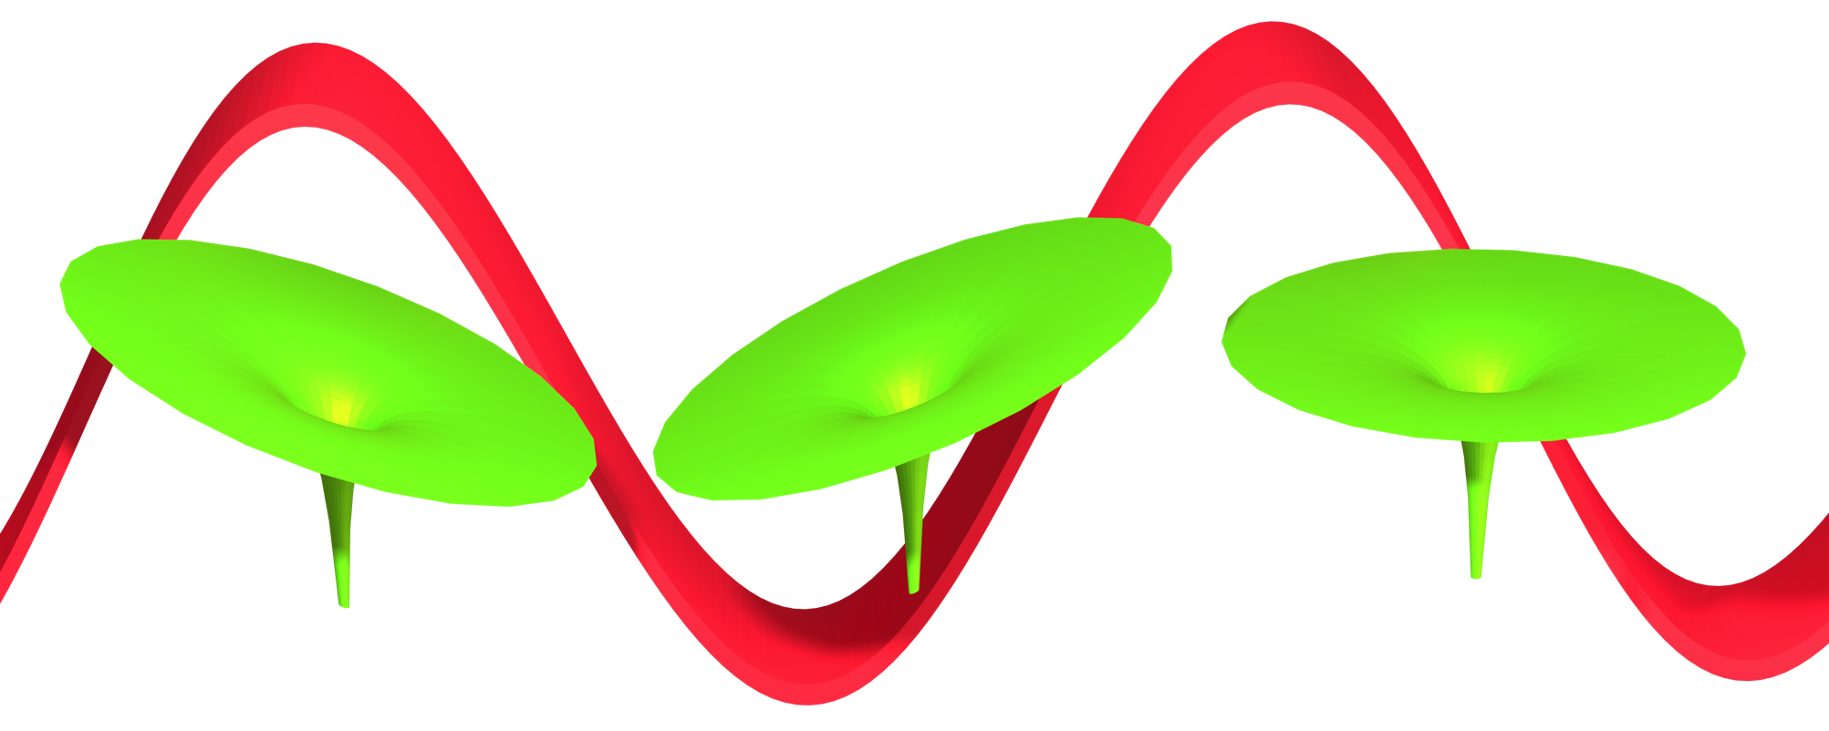
Strong field ionization complementary process to HHG
e
e
e
1. Tunnel ionization
2. Propagation in laser field
and coulomb potential
3. No recombination
(may scatter)
Notes:
But we can also look at the strong field ionization process, which is the complementary process to high harmonic generation. In strong field ionization, we look at electrons that tunnel ionize, propagate in the combined laser field and coulomb potential, but do not recombine with the ion. However, the electrons do have an opportunity to scatter from the coulomb potential. So, the question is if we can visualize this scattering process by looking at the momentum distribution of the electrons that are ionized by strong two-color laser fields.

